Slide 1


1995
Matteo Alberici
Software Atelier 1

Slide 2

HISTORY

Slide 3

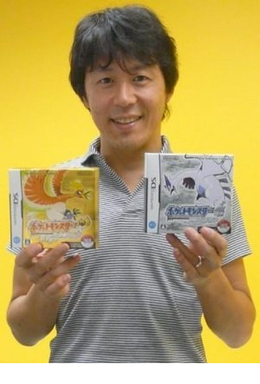
Satoshi Tajiri
Shigeki Morimoto

Slide 4
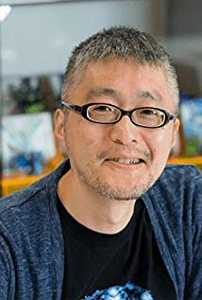
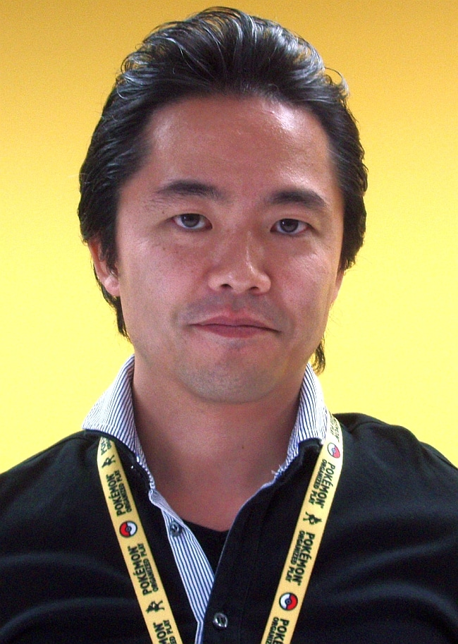
Ken Sugimori
Junichi Masuda

Slide 5
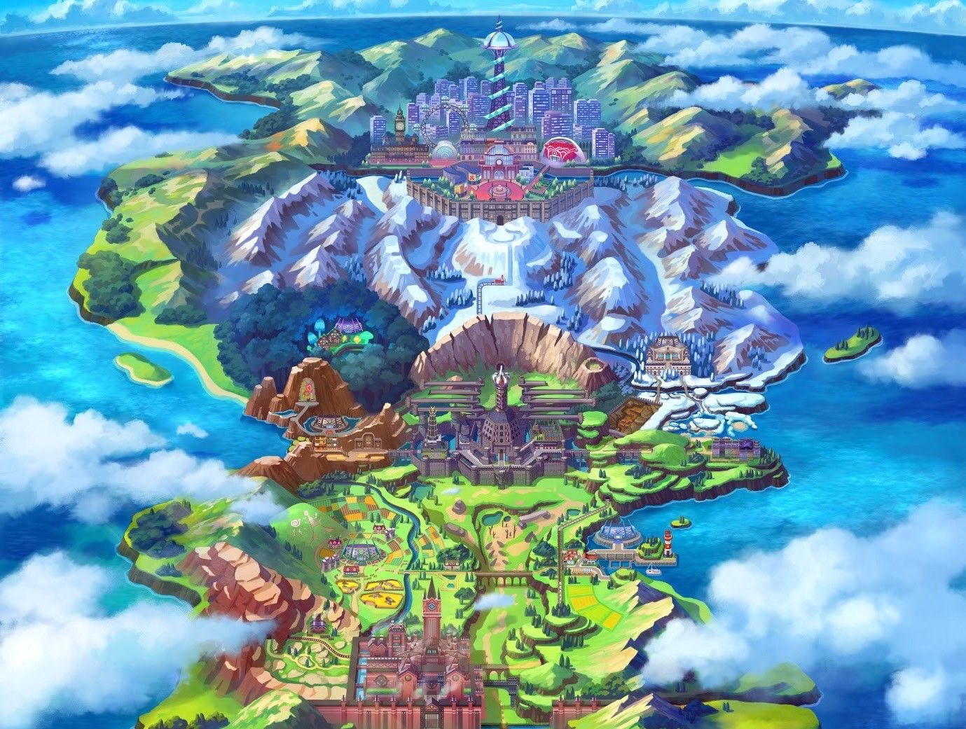
PLOT

Slide 6

Trainer

Slide 7
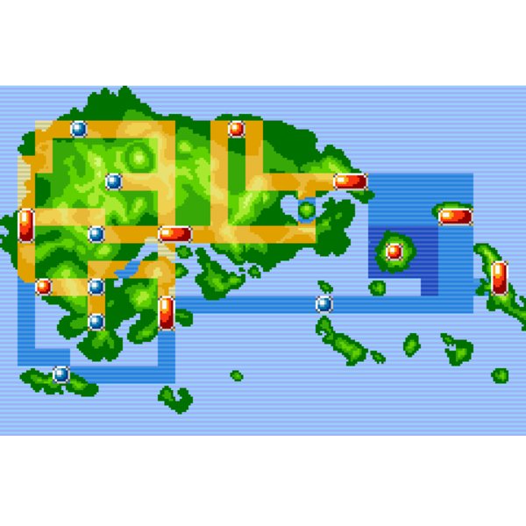
Trainer

Slide 8

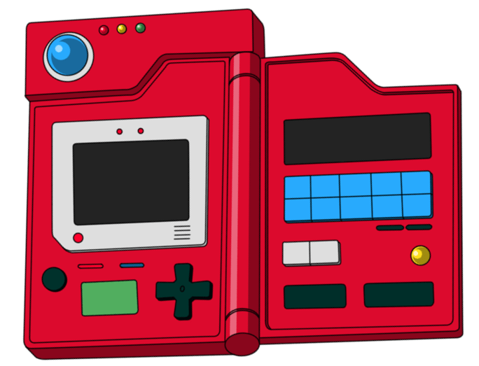
Trainer
Pokedex

Slide 9

Badges
Trainer

Slide 10
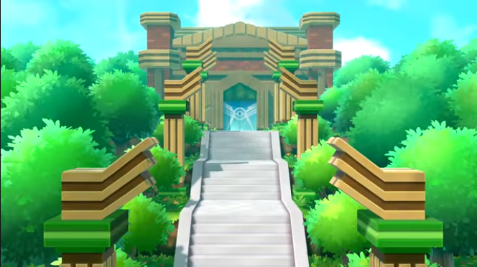
Badges
Trainer
Pokemon League

Slide 11
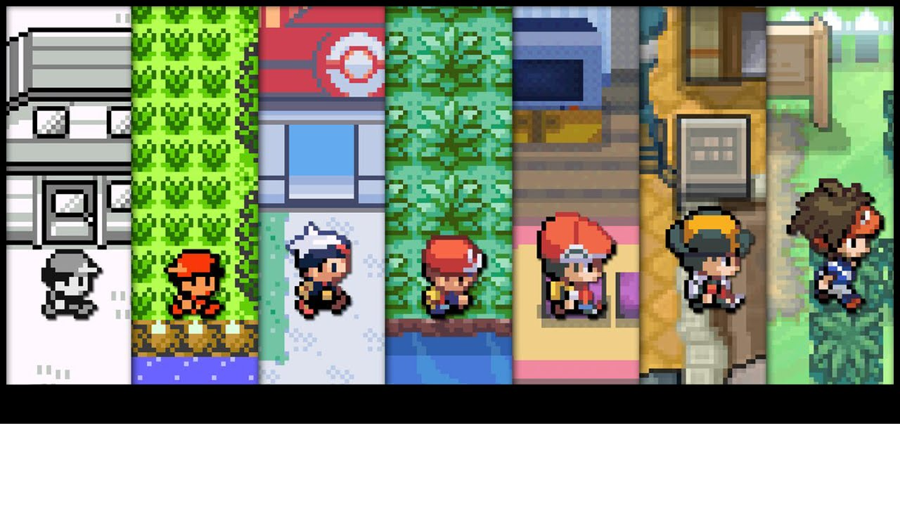
GRAPHIC EVOLUTION

Slide 12


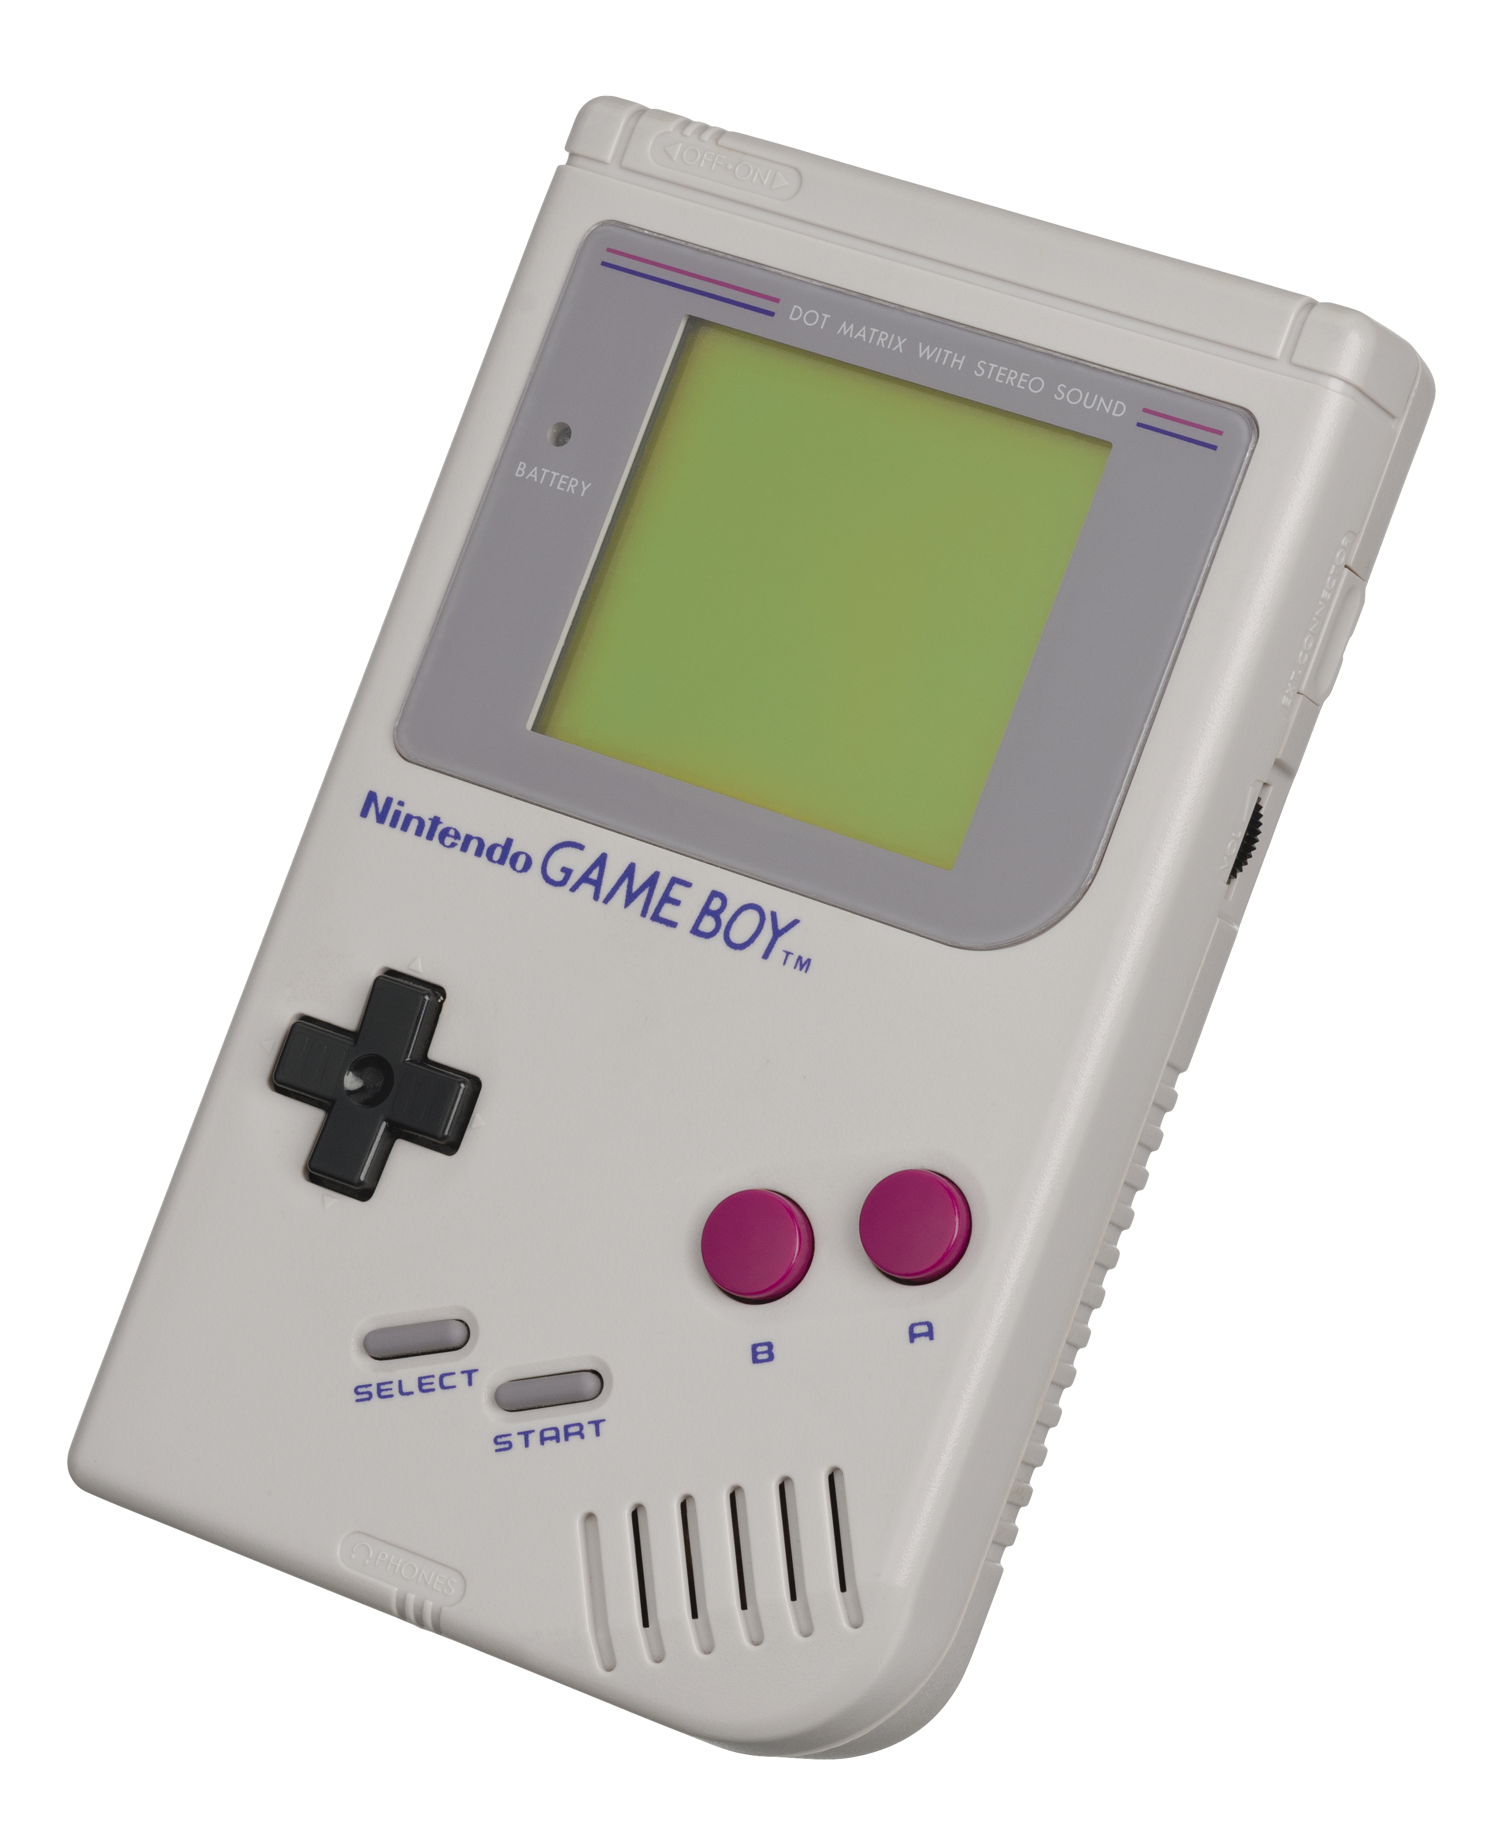
Pokemon Green
Pokemon Red
Gameboy

Slide 13
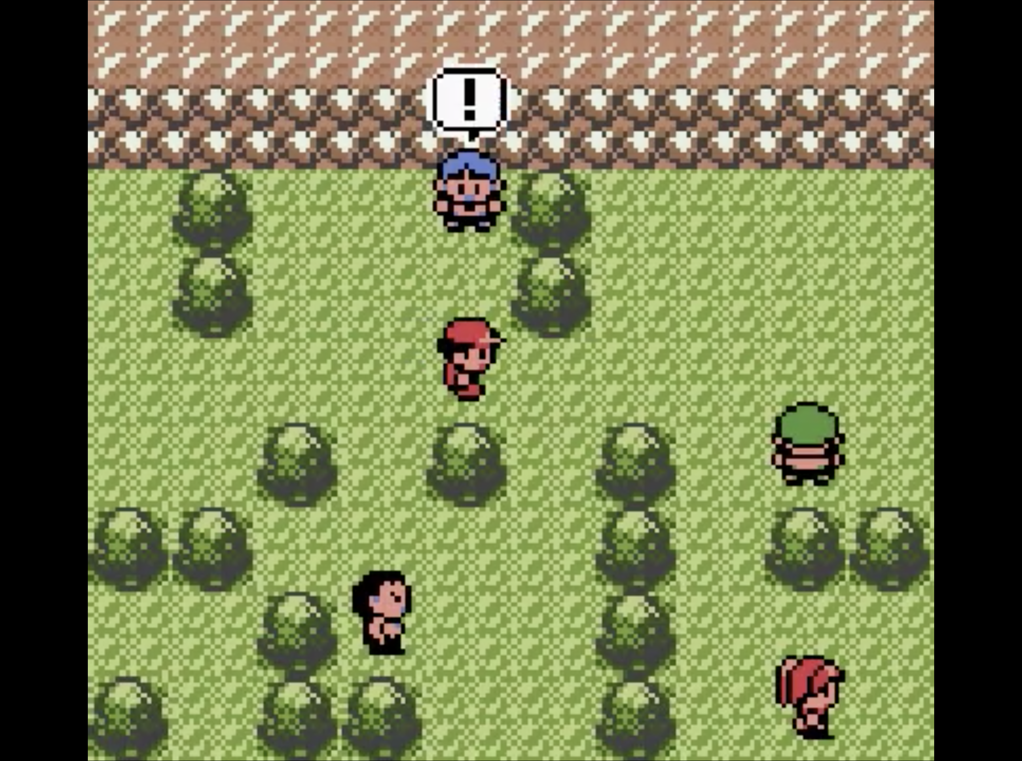
Pokemon Red, 1996

Slide 14

Red
1996

Slide 15

Red
1996
Ruby
2002

Slide 16

Red
1996
Red
1996
Ruby
2002
Ruby
2002
Leaf Green
2004

Slide 17

Red
1996
Red
1996
Ruby
2002
Ruby
2002
Leaf Green
2004
Leaf Green
2004
Pearl
2006

Slide 18

Red
1996
Red
1996
Ruby
2002
Ruby
2002
Leaf Green
2004
Leaf Green
2004
Pearl
2006
Pearl
2006
Soul Silver
2009

Slide 19

Red
1996
Red
1996
Ruby
2002
Ruby
2002
Leaf Green
2004
Leaf Green
2004
Pearl
2006
Pearl
2006
Soul Silver
2009
Soul Silver
2009
Y
2013

Slide 20
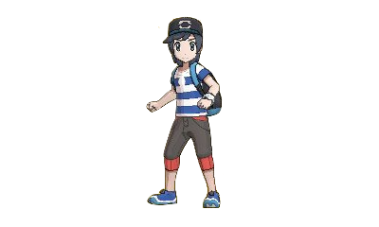
Red
1996
Ruby
2002
Leaf Green
2004
Pearl
2006
Soul Silver
2009
Y
2013
Sun
2016

Slide 21
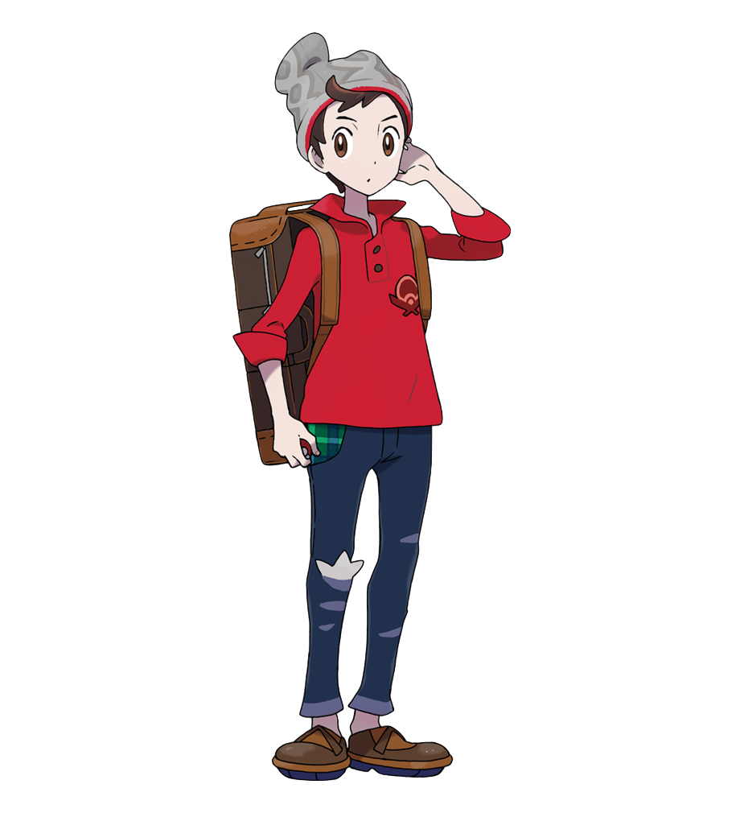
Red
1996
Ruby
2002
Leaf Green
2004
Pearl
2006
Soul Silver
2009
Y
2013
Sun
2016
Shield
2019

Slide 22


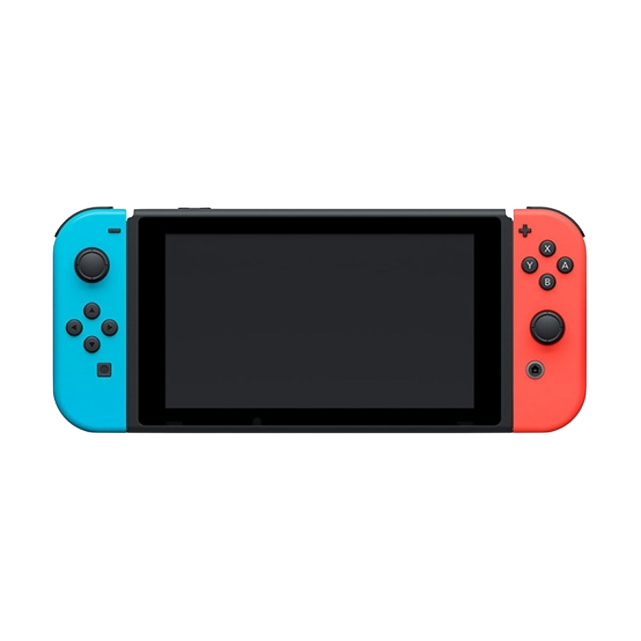
Pokemon Shield
Pokemon Sword
Nintendo Switch

Slide 23
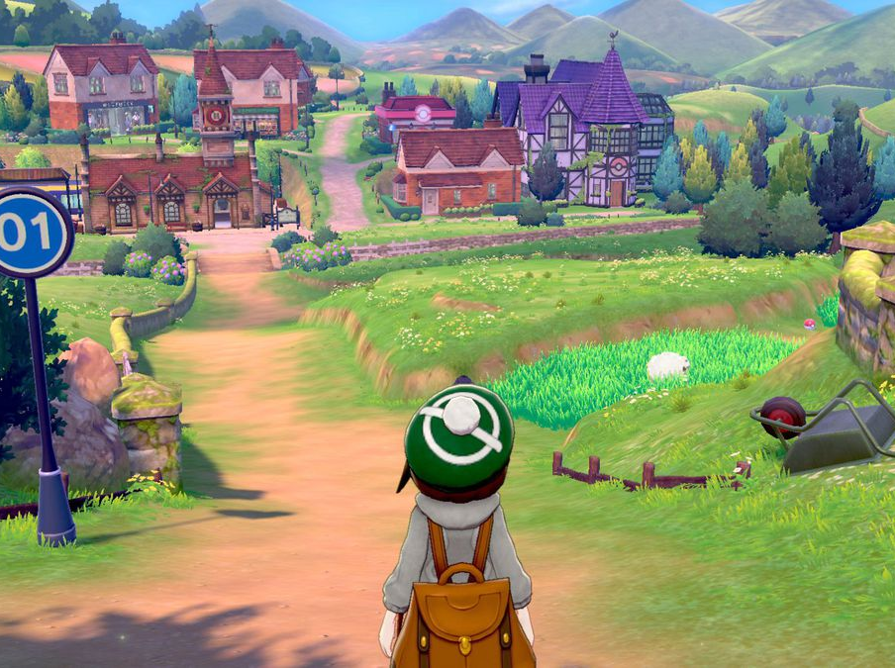
Pokemon Shield, 2019

Slide 24
“I see now that the circumstances of one's birth are irrelevant.
It is what you do with the gift of life that determines who you are.”

Slide 25


“I see now that the circumstances of one's birth are irrelevant.
It is what you do with the gift of life that determines who you are.”
Mewtwo
Mewtwo strikes back (1998)

Slide 26
Thanks for listening!
(and do not forget to catch’em all!”)

